Slide 1

G U A T E M A L A

Slide 2
G U A T E M A L A
2014:
Team Amaranth

Slide 3
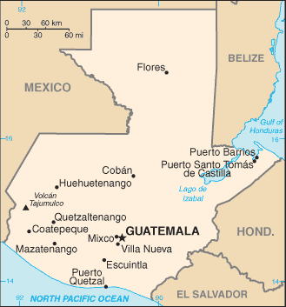
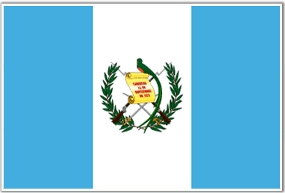
Guatemala
Area: 42, 042 sq. mi
Capital: Guatemala City
population of 2.5 M

Slide 4
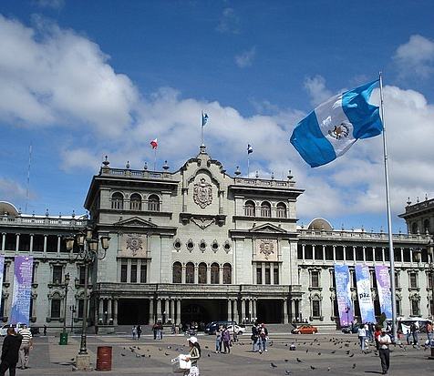
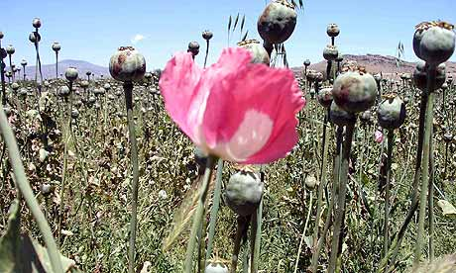
Guatemala’s Government
1820: Independence from Spain
1840: Becomes sovereign state
1944-1954: Social- democratic reform
1960-1996: Civil War
1996-current: Democratic government
President, congress, supreme court
Current Issues
Poverty
Inequality
Crime and Drug Trade

Slide 5
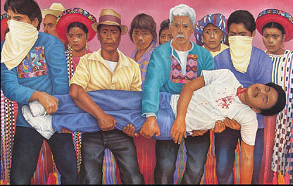
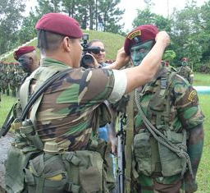
Civil War
1952 – Agrarian Reform redistributes land
1954 – President Jacobo Árbenz Guzmán is overthrown; Castillo Armas institutes military regime and reverses land reform
1960-1996 Civil War
Estimated 200,000 died including 40-50,000 missing
Government forces massacred entire peasant communities and guerilla sympathizers
1996 – Peace Accords are signed

Slide 6

CRS Guatemala Title II Food Program
The Food for Peace Act accounts for 50-90% of total annual international food aid spending from U.S.
In FY 2012, $1.466 billion in Title II was appropriated by Congress
(Avg. $2.2 billion/yr 2002-2011)
Primarily is through the donation of agricultural commodities
“Safe box” (nonemergency, development) funding was set at $400 million for FY 2013
This is where the funds for CRS’ 6-year program come from
A portion of these funds are provided through monetization
Can be cut into if 3 criteria is met in the case of a food emergency
Notes:
Challenge group to think about what the constraints are – want them looking at constraints that go beyond resources: social? principles? CRS has many.

Slide 7
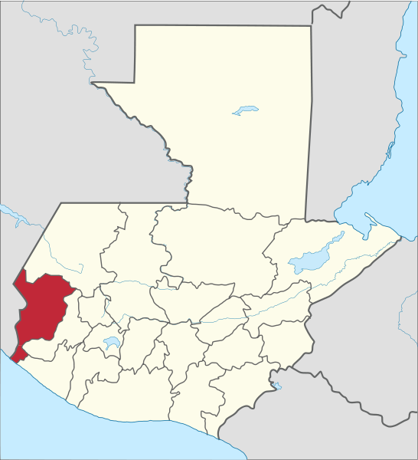
San Marcos, Guatemala
Poverty
70.3% poverty
14.9% extreme poverty
In 2012 was hit by
7.4 M earthquake
Suffered severe sanitation/property crisis
Notes:
Challenge group to think about what the constraints are – want them looking at constraints that go beyond resources: social? principles? CRS has many.

Slide 8
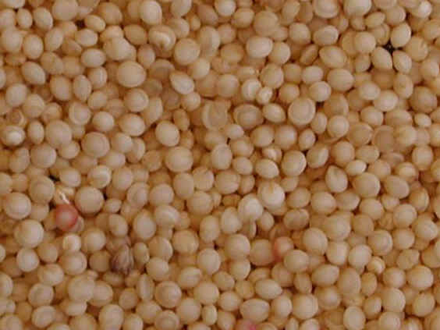
Scope of Work - Amaranth
Investigative goals
General
Value chain: local, national, and international
Local Consumption/Markets
Local cultural acceptance
Current consumption
Cost-benefit analysis of amaranth production for individual producer
National/International Sales
Required supply to satisfy market demand
Post-harvest processing
Health and safety standards Identify potential obstacles and/or restrictions for small producers looking to enter the amaranth market
Partnership with multinational food corporation to develop healthy amaranth snacks
Deliverables
Business plan for a small producer and producer organization for national sales
Characterize the current state of the amaranth market in Guatemala including growth potential and marketing recommendations
Notes:
Challenge group to think about what the constraints are – want them looking at constraints that go beyond resources: social? principles? CRS has many.

Slide 9
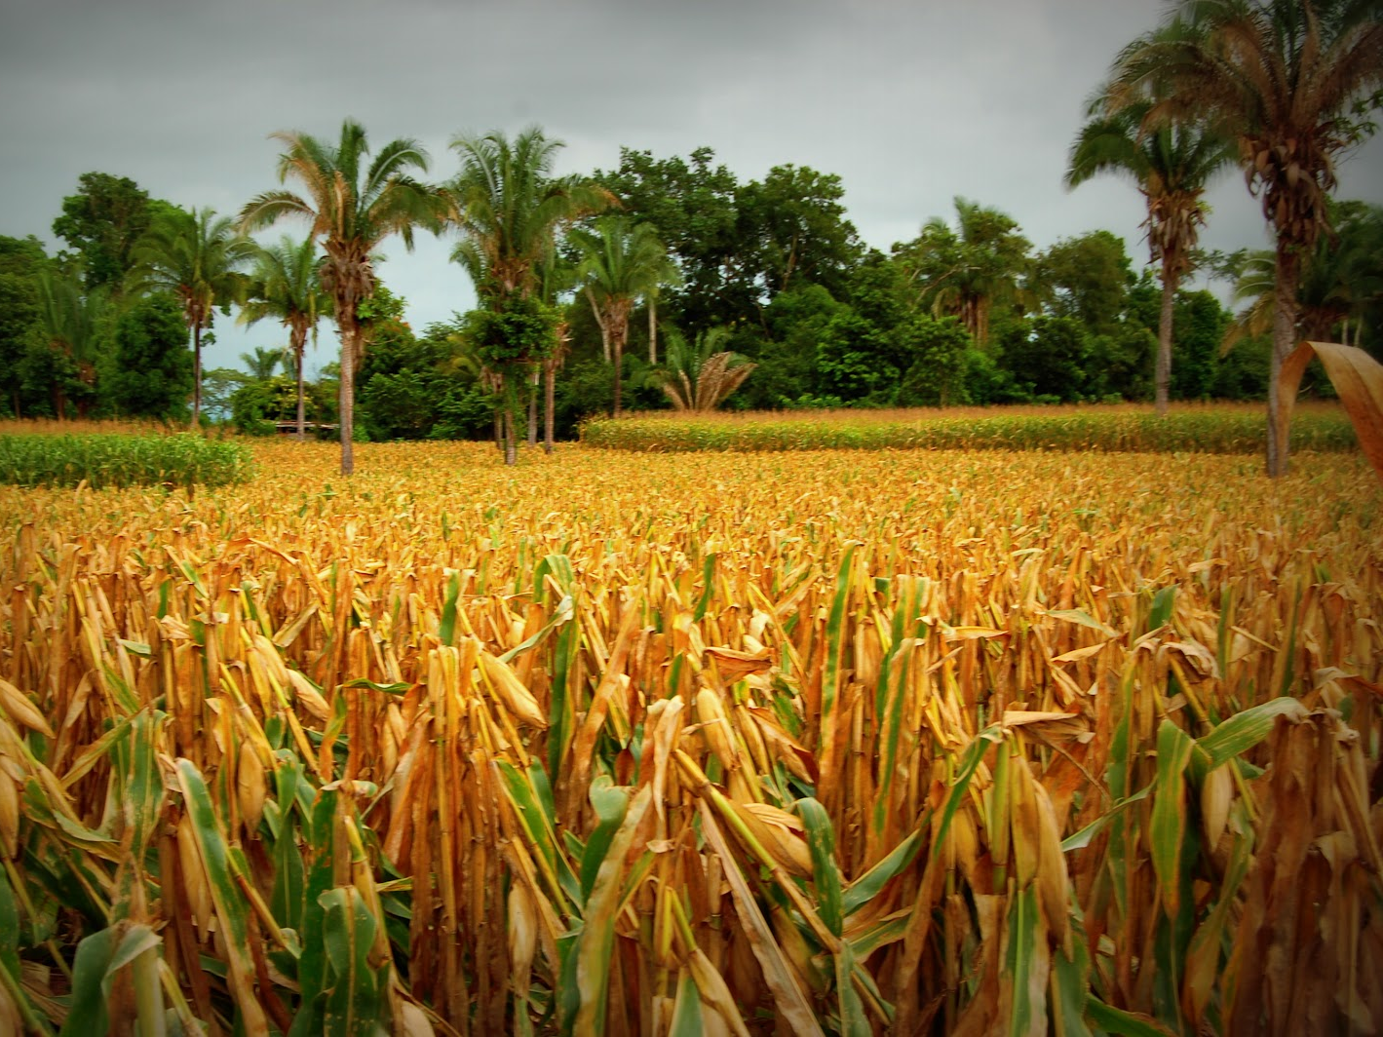
Guatemala Agriculture (Corn)
Corn is the primary staple crop (beans #2)
Maize (non-sweet corn) and elote (sweet corn)
C4 crop: drought tolerance
Low labor, no sophisticated processing required
80-90% of production is consumed locally ⇒ want to connect to markets
Small rented plots
Amaranth was outlawed by conquistadores in an effort to convert natives to Christianity ⇒ replaced with corn and other crops
Notes:
Challenge group to think about what the constraints are – want them looking at constraints that go beyond resources: social? principles? CRS has many.

Slide 10
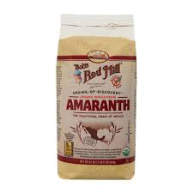
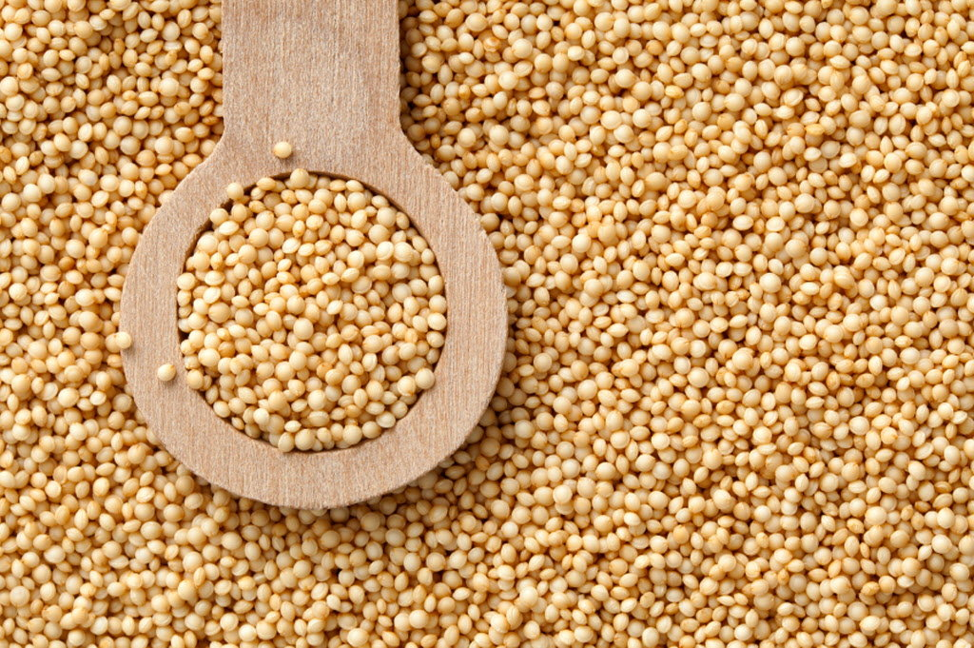
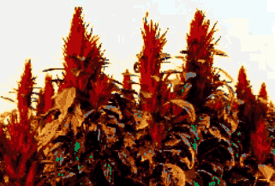
Amaranth: The Aztec Superfood
Former staple destroyed by Spanish Conquistadors -1500s
Grain W/ 15% Protein & Key Amino Acids
Drought Tolerant & Adaptable
Grind into Flours – Maintain Taste w/ 75%mix
Attractive Market Price for Farmers C4 Plant
Notes:
Teaching notes should encourage further research into the export/value chain of the banana, complexities thereof.

Slide 11
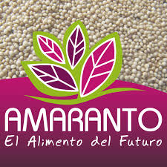
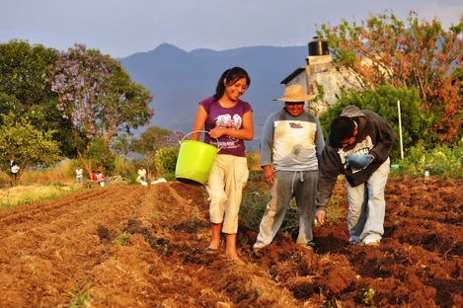
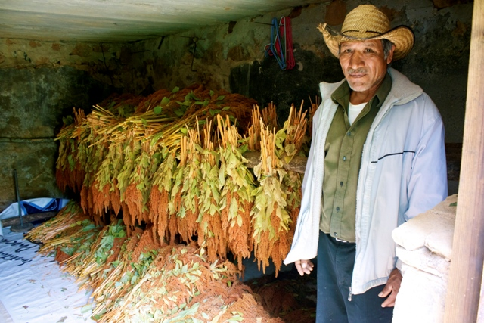
Amaranth Community Projects:
Mexico and Guatemala
Main focus: incorporating amaranth into community diet for the nutritional benefits
Local market
Have over ten years of experience
Focus efforts on women
Example: Los Puentes, Intervida
Mexico Tierra de Amaranto
Notes:
Challenge group to think about what the constraints are – want them looking at constraints that go beyond resources: social? principles? CRS has many.

Slide 12
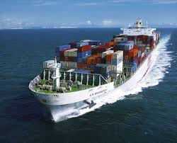
International Trade
Exports – $9.2 Billion
Imports – $10.6 Billion
Export partners
US 40.2%, El Salvador 11.1%, Honduras 8%, Mexico 5.5%, Nicaragua 4.7%, Costa Rica 4.3%
Export Agriculture
12% sugar, 9% coffee, 6% bananas, 3.4% nutmeg*
Import partners
US 38%, Mexico 11.3%, China 7.4%, El Salvador 4.6%
Import Agriculture
Corn seed (1.28%) Wheat and Meslin (1.07%
Notes:
Challenge group to think about what the constraints are – want them looking at constraints that go beyond resources: social? principles? CRS has many.

Slide 13
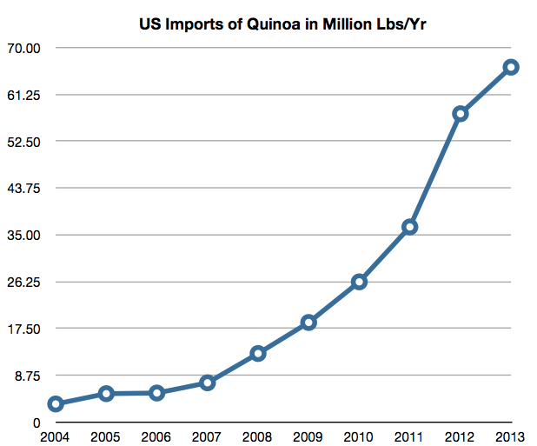
Quinoa
We consider Quinoa a model to learn from
Similarities:
Super Grain from South/Central America
Gluten-Free
Both eaten by pre-Columbian indigenousness Peoples
Notes:
Challenge group to think about what the constraints are – want them looking at constraints that go beyond resources: social? principles? CRS has many.

